Slide 1

Programming on Python
Lecture 14
Searching, Sorting, and Complexity Analysis
Complied by
Aizhan Altaibek

Slide 2
Content
Searching Algorithms
Sorting Algorithms
Complexity Analysis

Slide 3
Searching Algorithms in Python

Slide 4

Searching Algorithms
Finding information stored in various data structures is an important part of almost every application.
There are many different algorithms that can be used for searching. Each of them has different implementations and directly depends on the data structure for which it is implemented.
The ability to choose the right algorithm for a specific task is a key skill for developers. It is a well-chosen algorithm that distinguishes a fast, reliable and stable application.

Slide 5
SEARCHING ALGORITHMS IN PYTHON
Searching algorithm – method for ﬁnding an item or group of items with speciﬁc properties within a collection of items.
Python has the following search algorithms:
Membership Operators
Linear Search
Binary Search
Jump Search
Fibonacci Search
Exponential Search
Interpolation Search

Slide 6
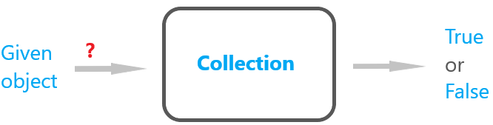
Membership Operators
Finding the presence of an item in a collection is a basic algorithm in almost every programming language. Usually - in the form of a function that returns a Boolean value True or False.
In Python, the easiest way to find an object is to use the Membership Operators. Their name is due to the fact that they allow us to determine whether a given object is a member of a collection.

Slide 7
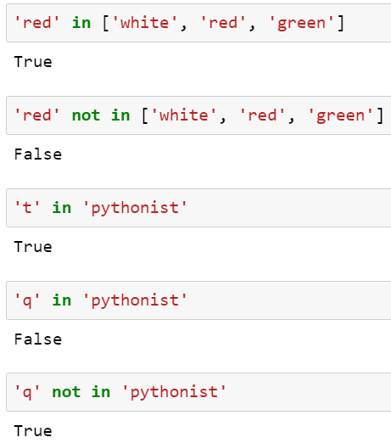
Membership Operators
These operators can be used with any iterable data structure in Python, including Strings, Lists, Tuples, etc.
in - Returns True if the given element is a part of the structure.
not in - Returns True if the given element is not a part of the structure.
The time complexity of membership operators is O(1)

Slide 8

O(1) complexity
Big O notation is used to describe the complexity of algorithms.
O(1) - complexity
How complex is this algorithm? It is necessary to describe the complexity of operations in terms of the number of operations performed to achieve the result.
How much will the number of operations increase with an increase in the number of input parameters, depending on the input (operations on input).
There are 5 inputs, because there are 5 elements in the List. To get result, we need to perform one operation.
Inputs | Operations
5 | 1
100 | 1
1 000 000 | 1
… | 1
O(1) - order 1 complexity.
1 operation for all possible inputs.
The most efficient.
Notes:
How complex is this algorithm? You can say: "not complicated at all - just take the first element of the array." This is true, but it is more correct to describe complexity in terms of the number of operations performed to achieve the result, depending on the input (operations on input).In other words: how much will the number of operations increase with an increase in the number of input parameters.
In our example, there are 5 inputs, because there are 5 elements in the array. To get the result, you need to perform one operation (take the element by index). How many operations will it take if there are 100 elements of the array? Or 1000? Or 100,000? All the same, only one operation is needed.

Slide 9
In most cases, in addition to determining whether an element is in the collection, we also need the position (index) of the element. By using membership operators, we cannot get it.
There are many search algorithms that do not depend on built-in operators and can be used to find values faster and / or more efficiently.
In addition, they can provide more information (for example, about the position of an item in a collection) rather than simply determine if the item is in the collection.

Slide 10
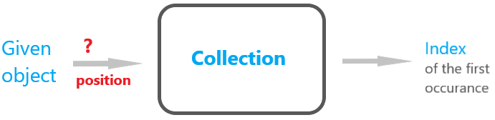
Linear Search
Linear search is one of the simplest and most understandable search algorithms.
We can think of it as an extended version of our own implementation of the in operator in Python.
The essence of the algorithm is to iterate over the collection and return the index of the first occurrence of the element when it is found:

Slide 11
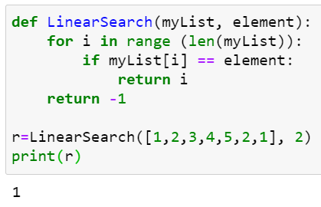
Linear Search
The time complexity of linear search is O(n).
This means that the time it takes to execute increases as the number of items in our input list myList increases.

Slide 12
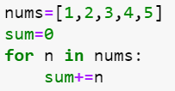
O(n) complexity
O(n) - complexity
How many input operations do we need?
Here we need to iterate over all the elements, i.e. operation for each element. The larger the collection, the more operations.
In Big O notation, the worst case is always considered - the element we are looking for may be the very last one.
Inputs | Operations
5 | 5
100 | 100
1 000 000 | 1 000 000
… | ..
O(n) - order n complexity.

Slide 13
Linear Search
Linear search is not often used in practice because the same efficiency can be achieved using built-in methods or existing operators.
In addition, it is not as fast and efficient as other search algorithms.
Linear search is good for when we need to find the first occurrence of an element in an unsorted collection. This is because it does not require sorting the collection before searching (unlike most other search algorithms).

Slide 14
Binary Search
Binary search follows a divide and conquer methodology. It is faster than linear search but requires that the collection be sorted before the algorithm is executed.
Assuming that we're searching for a value val in a sorted collection, the algorithm compares val to the value of the middle element of the collection, which we'll call mid.
mid=30
val=20
10 | 20 | 30 | 40 | 50
0 | 1 | 2 | 3 | 4
1
Notes:
If mid is the element we are looking for (best case), we return its index.
If not, we identify which side of mid val is more likely to be on based on whether val is smaller or greater than mid, and discard the other side of the array.
We then recursively or iteratively follow the same steps, choosing a new value for mid, comparing it with val and discarding half of the possible matches in each iteration of the algorithm.

Slide 15
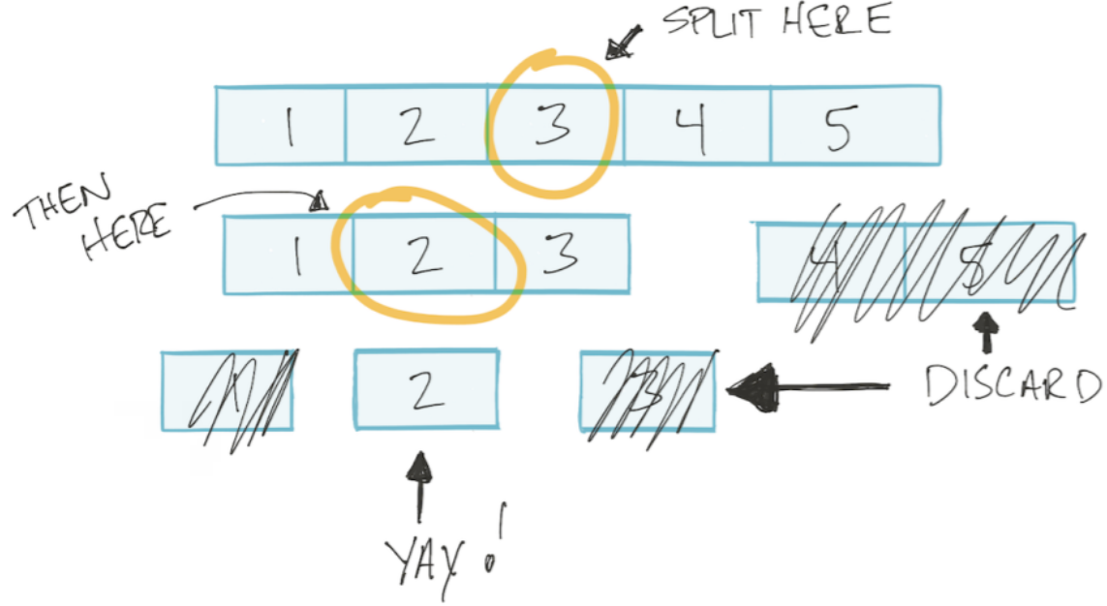
Binary Search

Slide 16
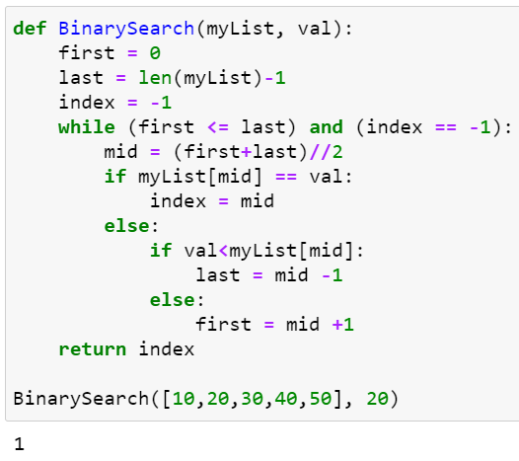
Binary Search
The binary search algorithm can be written either recursively or iteratively. Recursion is generally slower in Python because it requires the allocation of new stack frames.
Since a good search algorithm should be as fast and accurate as possible, let's consider the iterative implementation of binary search:

Slide 17
Binary Search
The action that the algorithm performs next in each iteration is one of several possibilities:
Returning the index of the current element
Searching through the left half of the collection
Searching through the right half of the collection
We can only pick one possibility per iteration, and our pool of possible matches gets divided by two in each iteration. This makes the time complexity of binary search O(log n).

Slide 18
O(log n) complexity of Binary Search
In the worst case, we do as many operations as we can split the collection into two parts.
For example, how many times can we halve a collection of 4 elements? 2 times.
What about an array of 8 elements? 3 times.
O(log n) - complexity.
Elements number (n) | Splitting times | log n
4 | 2 | log₂4=2
8 | 3 | log₂8=3
10 | 3.322 | log₂10=3.322
100 | 6.644 | log₂100=6.644
log n < n

Slide 19

Binary Search
One drawback of binary search is that if there are multiple occurrences of an element in the collection, it does not return the index of the first element, but rather the index of the element closest to the middle:
However, we cannot categorically say that binary search does not work if an array contains the same element twice - it can work just like linear search and return the first occurrence of the element in some cases.

Slide 20
Binary Search
Binary search is quite commonly used in practice because it is efficient and fast when compared to linear search. However, it does have some shortcomings, such as its reliance on the // operator. There are many other divide and conquer search algorithms that are derived from binary search.

Slide 21
Jump Search
Jump Search is similar to binary search in that it works on a sorted collection, and uses a similar divide and conquer approach to search through it.
It can be classified as an improvement of the linear search algorithm since it depends on linear search to perform the actual comparison when searching for a value.

Slide 22
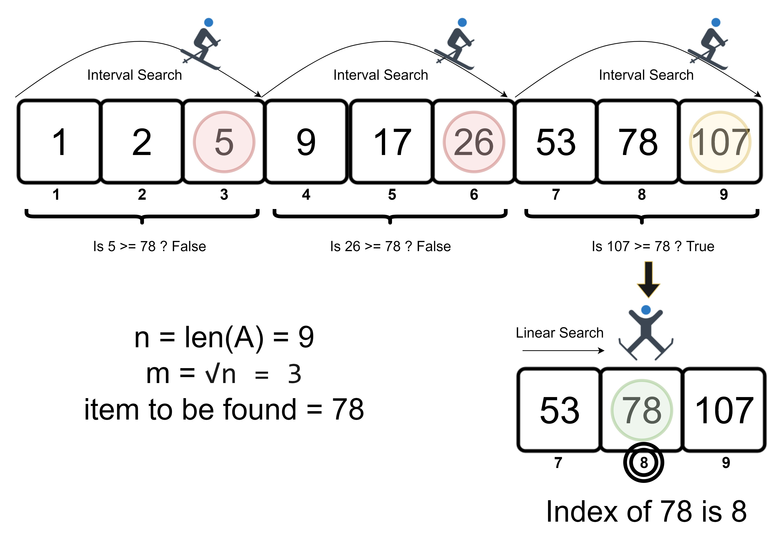

Slide 23
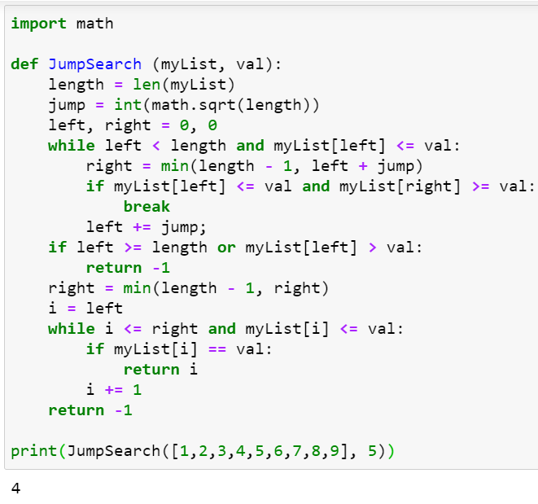
Jump Search
Given a sorted array, instead of searching through the array elements incrementally, we search in jumps. So in our input list myList, if we have a jump size of jump our algorithm will consider elements in the order myList[0], myList[0+jump], myList[0+2jump], myList[0+3jump] and so on.
With each jump, we store the previous value we looked at and its index. When we find a set of values where myList[i]<element< myList[i+jump], we perform a linear search with myList[i] as the left-most element and myList[i+jump] as the right-most element in our search set:
Notes:
Jump search would first determine the jump size by computing math.sqrt(len(myList)). Since we have 9 elements, the jump size would be √9 = 3.
Next, we compute the value of the right variable, which is the minimum of the length of the array minus 1, or the value of left+jump, which in our case would be 0+3= 3. Since 3 is smaller than 8 we use 3 as the value of right.
Now we check whether our search element, 5, is between myList[0] and myList[3]. Since 5 is not between 1 and 4, we move on.
Next, we do the calculations again and check whether our search element is between myList[3] and myList[6], where 6 is 3+jump. Since 5 is between 4 and 7, we do a linear search on the elements between myList[3] and myList[6] and return the index of our element as: 4

Slide 24
Jump Search
The time complexity of jump search is O(√n)
where √n is the jump size, and n is the length of the list.
Thus, in terms of efficiency, jump search is between linear and binary search algorithms.
The single most important advantage of jump search over binary search is that it does not rely on the division operator (/).

Slide 25
Fibonacci Search
Fibonacci search is another divide and conquer algorithm which bears similarities to both binary search and jump search. It gets its name because it uses Fibonacci numbers to calculate the block size or search range in each step.
Fibonacci numbers start with zero and follow the pattern
0, 1, 1, 2, 3, 5, 8, 13, 21...
where each element is the addition of the two numbers that immediately precede it.

Slide 26
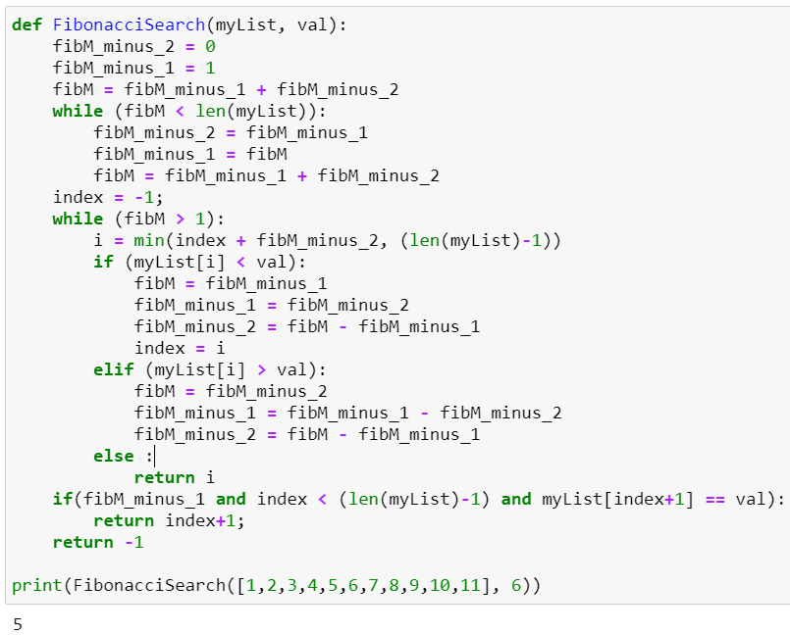
Fibonacci Search
The algorithm works with three Fibonacci numbers at a time.
Let's call the three numbers:
fibM, fibM_minus_1, and fibM_minus_2
where fibM = fibM_minus_1 + fibM_minus_2
We initialize the values to 0,1, 1 or the first three numbers in the Fibonacci sequence to avoid getting an index error in the case where our search array myList contains a very small number of items.
Notes:
Then we choose the smallest number of the Fibonacci sequence that is greater than or equal to the number of elements in our search array myList, as the value of fibM, and the two Fibonacci numbers immediately before it as the values of fibM_minus_1 and fibM_minus_2. While the array has elements remaining and the value of fibM is greater than one, we:
Compare val with the value of the block in the range up to fibM_minus_2, and return the index of the element if it matches.
If the value is greater than the element we are currently looking at, we move the values of fibM, fibM_minus_1 and fibM_minus_2 two steps down in the Fibonacci sequence, and reset the index to the index of the element.
If the value is less than the element we are currently looking at, we move the values of fibM, fibM_minus_1 and fibM_minus_2 one step down in the Fibonacci sequence.
Introduction
Searching for data stored in different data structures is a crucial part of pretty much every single application.
There are many different algorithms available to utilize when searching, and each have different implementations and rely on different data structures to get the job done.
Being able to choose a specific algorithm for a given task is a key skill for developers and can mean the difference between a fast, reliable and stable application and an application that crumbles from a simple request.
Membership Operators
Linear Search
Binary Search
Jump Search
Fibonacci Search
Exponential Search
Interpolation Search
Membership Operators
Algorithms develop and become optimized over time as a result of constant evolution and the need to find the most efficient solutions for underlying problems in different domains.
One of the most common problems in the domain of Computer Science is searching through a collection and determining whether a given object is present in the collection or not.
Almost every programming language has its own implementation of a basic search algorithm, usually as a function which returns a Boolean value of True or False when an item is found in a given collection of items.
In Python, the easiest way to search for an object is to use Membership Operators - named that way because they allow us to determine whether a given object is a member in a collection.
These operators can be used with any iterable data structure in Python, including Strings, Lists, and Tuples.
in - Returns True if the given element is a part of the structure.
not in - Returns True if the given element is not a part of the structure.
>>> 'apple' in ['orange', 'apple', 'grape'] True >>> 't' in 'stackabuse' True >>> 'q' in 'stackabuse' False >>> 'q' not in 'stackabuse' True Membership operators suffice when all we need to do is find whether a substring exists within a given string, or determine whether two Strings, Lists, or Tuples intersect in terms of the objects they hold.
In most cases we need the position of the item in the sequence, in addition to determining whether or not it exists; membership operators do not meet this requirement.
There are many search algorithms that don't depend on built-in operators and can be used to search for values faster and/or more efficiently. In addition, they can yield more information, such as the position of the element in the collection, rather than just being able to determine its existence.
Linear Search
Linear search is one of the simplest searching algorithms, and the easiest to understand. We can think of it as a ramped-up version of our own implementation of Python's in operator.
The algorithm consists of iterating over an array and returning the index of the first occurrence of an item once it is found:
def LinearSearch(myList, element): for i in range (len(myList)): if myList[i] == element: return i return -1 So if we use the function to compute:
>>> print(LinearSearch([1,2,3,4,5,2,1], 2)) Upon executing the code, we're greeted with:
1 This is the index of the first occurrence of the item we are searching for - keeping in mind that Python indexes are 0-based.
The time complexity of linear search is O(n), meaning that the time taken to execute increases with the number of items in our input list myList.
Linear search is not often used in practice, because the same efficiency can be achieved by using inbuilt methods or existing operators, and it is not as fast or efficient as other search algorithms.
Linear search is a good fit for when we need to find the first occurrence of an item in an unsorted collection because unlike most other search algorithms, it does not require that a collection be sorted before searching begins.
Binary Search
Binary search follows a divide and conquer methodology. It is faster than linear search but requires that the array be sorted before the algorithm is executed.
Assuming that we're searching for a value val in a sorted array, the algorithm compares val to the value of the middle element of the array, which we'll call mid.
If mid is the element we are looking for (best case), we return its index.
If not, we identify which side of mid val is more likely to be on based on whether val is smaller or greater than mid, and discard the other side of the array.
We then recursively or iteratively follow the same steps, choosing a new value for mid, comparing it with val and discarding half of the possible matches in each iteration of the algorithm.
The binary search algorithm can be written either recursively or iteratively. Recursion is generally slower in Python because it requires the allocation of new stack frames.
Since a good search algorithm should be as fast and accurate as possible, let's consider the iterative implementation of binary search:
def BinarySearch(myList, val): first = 0 last = len(myList)-1 index = -1 while (first <= last) and (index == -1): mid = (first+last)//2 if myList[mid] == val: index = mid else: if val<myList[mid]: last = mid -1 else: first = mid +1 return index If we use the function to compute:
>>> BinarySearch([10,20,30,40,50], 20) We get the result:
1 Which is the index of the value that we are searching for.
The action that the algorithm performs next in each iteration is one of several possibilities:
Returning the index of the current element
Searching through the left half of the array
Searching through the right half of the array
We can only pick one possibility per iteration, and our pool of possible matches gets divided by two in each iteration. This makes the time complexity of binary search O(log n).
One drawback of binary search is that if there are multiple occurrences of an element in the array, it does not return the index of the first element, but rather the index of the element closest to the middle:
>>> print(BinarySearch([4,4,4,4,4], 4)) Running this piece of code will result in the index of the middle element:
1 For comparison performing a linear search on the same array would return:
0 Which is the index of the first element. However, we cannot categorically say that binary search does not work if an array contains the same element twice - it can work just like linear search and return the first occurrence of the element in some cases.
If we perform binary search on the array [1,2,3,4,4,5] for instance, and search for 4, we would get 3 as the result.
Binary search is quite commonly used in practice because it is efficient and fast when compared to linear search. However, it does have some shortcomings, such as its reliance on the // operator. There are many other divide and conquer search algorithms that are derived from binary search, let's examine a few of those next.
Jump Search
Jump Search is similar to binary search in that it works on a sorted array, and uses a similar divide and conquer approach to search through it.
It can be classified as an improvement of the linear search algorithm since it depends on linear search to perform the actual comparison when searching for a value.
Given a sorted array, instead of searching through the array elements incrementally, we search in jumps. So in our input list myList, if we have a jump size of jump our algorithm will consider elements in the order myList[0], myList[0+jump], myList[0+2jump], myList[0+3jump] and so on.
With each jump, we store the previous value we looked at and its index. When we find a set of values where myList[i]<element<myList[i+jump], we perform a linear search with myList[i] as the left-most element and myList[i+jump] as the right-most element in our search set:
import math def JumpSearch (myList, val): length = len(myList) jump = int(math.sqrt(length)) left, right = 0, 0 while left < length and myList[left] <= val: right = min(length - 1, left + jump) if myList[left] <= val and myList[right] >= val: break left += jump; if left >= length or myList[left] > val: return -1 right = min(length - 1, right) i = left while i <= right and myList[i] <= val: if myList[i] == val: return i i += 1 return -1 Since this is a complex algorithm, let's consider the step-by-step computation of jump search with this input:
>>> print(JumpSearch([1,2,3,4,5,6,7,8,9], 5)) Jump search would first determine the jump size by computing math.sqrt(len(myList)). Since we have 9 elements, the jump size would be √9 = 3.
Next, we compute the value of the right variable, which is the minimum of the length of the array minus 1, or the value of left+jump, which in our case would be 0+3= 3. Since 3 is smaller than 8 we use 3 as the value of right.
Now we check whether our search element, 5, is between myList[0] and myList[3]. Since 5 is not between 1 and 4, we move on.
Next, we do the calculations again and check whether our search element is between myList[3] and myList[6], where 6 is 3+jump. Since 5 is between 4 and 7, we do a linear search on the elements between myList[3] and myList[6] and return the index of our element as:
4 The time complexity of jump search is O(√n), where √n is the jump size, and n is the length of the list, placing jump search between the linear search and binary search algorithms in terms of efficiency.
The single most important advantage of jump search when compared to binary search is that it does not rely on the division operator (/).
In most CPUs, using the division operator is costly when compared to other basic arithmetic operations (addition, subtraction, and multiplication), because the implementation of the division algorithm is iterative.
The cost by itself is very small, but when the number of elements to search through is very large, and the number of division operations that we need to perform increases, the cost can add up incrementally. Therefore jump search is better than binary search when there is a large number of elements in a system where even a small increase in speed matters.
Subscribe to our Newsletter
Get occassional tutorials, guides, and jobs in your inbox. No spam ever. Unsubscribe at any time.
Newsletter Signup
Subscribe
To make jump search faster, we could use binary search or another internal jump search to search through the blocks, instead of relying on the much slower linear search.
Fibonacci Search
Fibonacci search is another divide and conquer algorithm which bears similarities to both binary search and jump search. It gets its name because it uses Fibonacci numbers to calculate the block size or search range in each step.
Fibonacci numbers start with zero and follow the pattern 0, 1, 1, 2, 3, 5, 8, 13, 21... where each element is the addition of the two numbers that immediately precede it.
The algorithm works with three Fibonacci numbers at a time. Let's call the three numbers fibM, fibM_minus_1, and fibM_minus_2 where fibM_minus_1 and fibM_minus_2 are the two numbers immediately before fibM in the sequence:
fibM = fibM_minus_1 + fibM_minus_2 We initialize the values to 0,1, and 1 or the first three numbers in the Fibonacci sequence to avoid getting an index error in the case where our search array myList contains a very small number of items.
Then we choose the smallest number of the Fibonacci sequence that is greater than or equal to the number of elements in our search array myList, as the value of fibM, and the two Fibonacci numbers immediately before it as the values of fibM_minus_1 and fibM_minus_2. While the array has elements remaining and the value of fibM is greater than one, we:
Compare val with the value of the block in the range up to fibM_minus_2, and return the index of the element if it matches.
If the value is greater than the element we are currently looking at, we move the values of fibM, fibM_minus_1 and fibM_minus_2 two steps down in the Fibonacci sequence, and reset the index to the index of the element.
If the value is less than the element we are currently looking at, we move the values of fibM, fibM_minus_1 and fibM_minus_2 one step down in the Fibonacci sequence.
Let's take a look at the Python implementation of this algorithm:
def FibonacciSearch(myList, val): fibM_minus_2 = 0 fibM_minus_1 = 1 fibM = fibM_minus_1 + fibM_minus_2 while (fibM < len(myList)): fibM_minus_2 = fibM_minus_1 fibM_minus_1 = fibM fibM = fibM_minus_1 + fibM_minus_2 index = -1; while (fibM > 1): i = min(index + fibM_minus_2, (len(myList)-1)) if (myList[i] < val): fibM = fibM_minus_1 fibM_minus_1 = fibM_minus_2 fibM_minus_2 = fibM - fibM_minus_1 index = i elif (myList[i] > val): fibM = fibM_minus_2 fibM_minus_1 = fibM_minus_1 - fibM_minus_2 fibM_minus_2 = fibM - fibM_minus_1 else : return i if(fibM_minus_1 and index < (len(myList)-1) and myList[index+1] == val): return index+1; return -1 If we use the FibonacciSearch function to compute:
>>> print(FibonacciSearch([1,2,3,4,5,6,7,8,9,10,11], 6)) Let's take a look at the step-by-step process of this search:
Determining the smallest Fibonacci number greater than or equal to the length of the list as fibM; in this case, the smallest Fibonacci number meeting our requirements is 13.
The values would be assigned as:
fibM = 13
fibM_minus_1 = 8
fibM_minus_2 = 5
index = -1
Next, we check the element myList[4] where 4 is the minimum of -1+5 . Since the value of myList[4] is 5, which is smaller than the value we are searching for, we move the Fibonacci numbers one step down in the sequence, making the values:
fibM = 8
fibM_minus_1 = 5
fibM_minus_2 = 3
index = 4
Next, we check the element myList[7] where 7 is the minimum of 4+3. Since the value of myList[7] is 8, which is greater than the value we are searching for, we move the Fibonacci numbers two steps down in the sequence.
fibM = 3
fibM_minus_1 = 2
fibM_minus_2 = 1
index = 4
Now we check the element myList[5] where 5 is the minimum of 4+1 . The value of myList[5] is 6, which is the value we are searching for!

Slide 27
Fibonacci Search
The time complexity for Fibonacci search is O(log n); the same as binary search. This means the algorithm is faster than both linear search and jump search in most cases.
Fibonacci search can be used when we have a very large number of elements to search through, and we want to reduce the inefficiency associated with using an algorithm which relies on the division operator.

Slide 28
Exponential Search
Exponential search is another search algorithm that can be implemented quite simply in Python, compared to jump search and Fibonacci search which are both a bit complex.
It is also known by the names galloping search, doubling search and Struzik search.
Complexity O(log n)
Exponential search depends on binary search to perform the final comparison of values. The algorithm works by:
Determining the range where the element we're looking for is likely to be
Using binary search for the range to find the exact index of the item

Slide 29
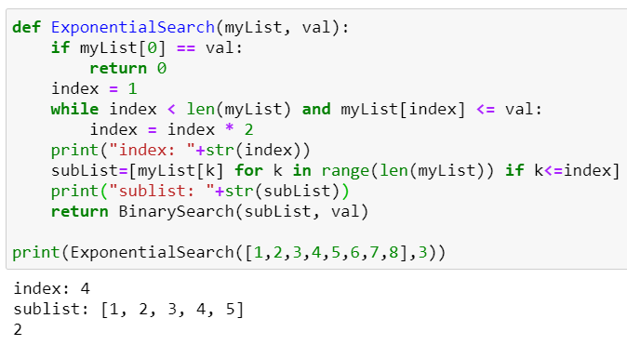
Exponential Search

Slide 30
Interpolation Search
Interpolation search is another divide and conquer algorithm, similar to binary search. Unlike binary search, it does not always begin searching at the middle.
The time complexity is O (log log n) when the values are evenly distributed.
The time complexity is O (n) when values are unevenly distributed.
Interpolation search calculates the probable position of the element we are searching for using the formula:
index = low + [(val-myList[low])*(high-low) / (myList[high]-myList[low])]
myList - our input collection
val - the element we are searching for
index - the probable index of the search element. This is computed to be a higher value when val is closer in value to the element at the end of the array (myList[high]), and lower when val is closer in value to the element at the start of the array (myList[low])
low - the starting index of the collection
high - the last index of the collection

Slide 31
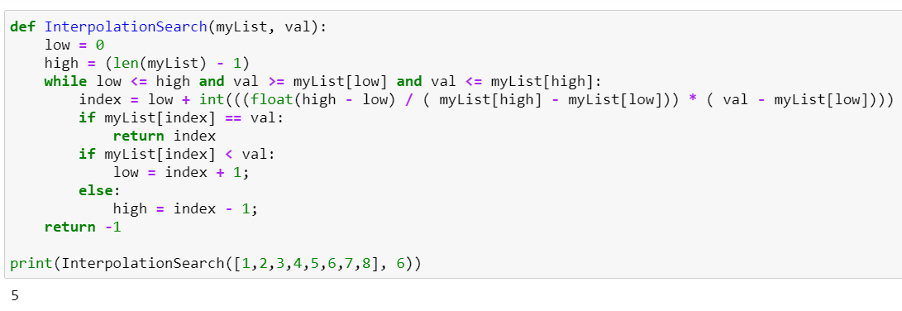
Interpolation Search
Notes:
The algorithm searches by calculating the index value:
If a value is found (when myList [index] == val), the index is returned.
If val is less than myList [index], then the index value is recalculated using the formula for the left subarray.
If val is greater than myList [index], then the index value is recalculated using the formula for the right subarray.

Slide 32
Using Search Algorithms
Search Algorithms
Linear search | If you want to search through an unsorted array or to find the first occurrence of a search variable
binary search | If you want to search through a sorted array, there are many options of which the simplest and fastest method
jump search or Fibonacci search | If you have a sorted array that you want to search through without using the division operator
exponential search | If you know that the element you're searching for is likely to be closer to the start of the array
interpolation search | If your sorted array is also uniformly distributed, the fastest and most efficient search algorithm
Notes:
https://stackabuse.com/search-algorithms-in-python/
https://techrocks.ru/2020/08/12/python-search-algorithms/

Slide 33
Sorting Algorithms in Python

Slide 34
SORTING ALGORITHMS
Sorting algorithms give us many ways to organize our data.
There are different algorithms and their implementations in Python:
Bubble Sort
Selection Sort
Insertion Sort
Merge Sort
Heap Sort
Quick Sort

Slide 35
Bubble Sort
This approach enumerates the list and compares adjacent elements. They are reversed if the order is incorrect. This continues until all the elements are arranged in the desired order.
Due to the high number of
repetitions of bubble sort,
its worst case complexity is
O (n ^ 2)

Slide 36
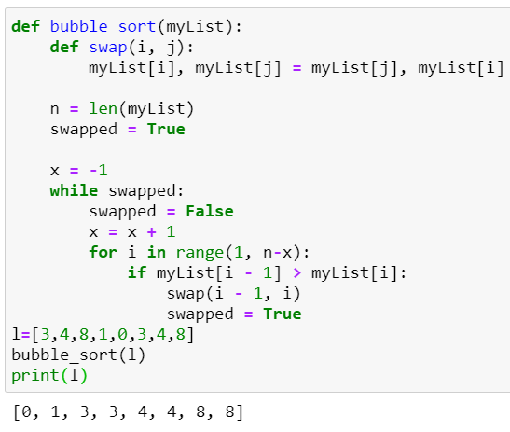
Bubble Sort
compare consecuve pairs
of elements
swap elements in pair such that smaller is ﬁrst
when reach end of list,
start over again
stop when no more swaps
have been made
O (n ^ 2)

Slide 37
Selection Sort
Selection sort is also a simple algorithm, but more efficient than bubble sort. In most cases, selection sort will be the better choice of the two.
In this algorithm, the list is divided into two parts: a list with sorted elements and a list with elements that only need to be sorted. The smallest element in the second is searched first. It is added at the end of the first. Thus, the algorithm gradually builds the list from smallest to largest. This happens until there is a ready sorted array.

Slide 38
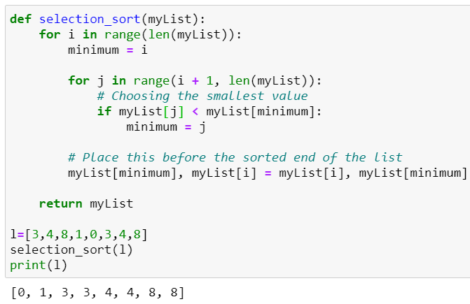
Selection Sort
ﬁrst step
extract minimum element
swap it with element at index 0
subsequent step
in remaining sublist, extract minimum element
swap it with the element at index 1
keep of the list sorted
at i’th step, ﬁrst i elements in list are sorted
all other elements are bigger than ﬁrst i elements
O (n ^ 2)

Slide 39
Insertion Sort
Insertion sort is faster and easier than the previous two.
At each iteration, the program takes one of the elements and looks for a place for it in the already sorted list. This happens until there is not a single unused element left.

Slide 40
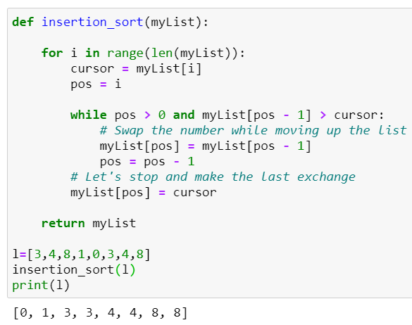
Insertion Sort
O (n ^ 2)

Slide 41
Merge Sort
Merge Sort is an elegant example of a Divide and Conquer approach. It consists of two stages:
The unsorted list is sequentially divided into N lists, where each contains one "unsorted" element, and N is the number of elements in the original array.
The lists are merged sequentially in groups of two, creating new sorted lists until one final sorted list appears.

Slide 42
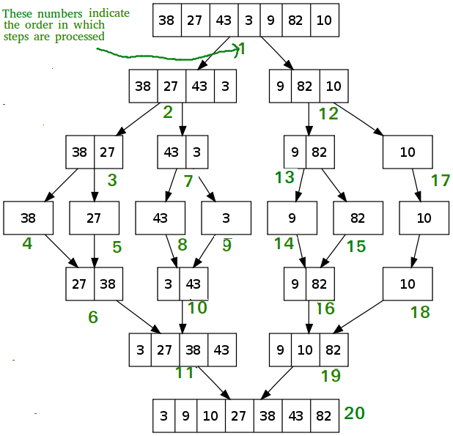
Merge Sort

Slide 43
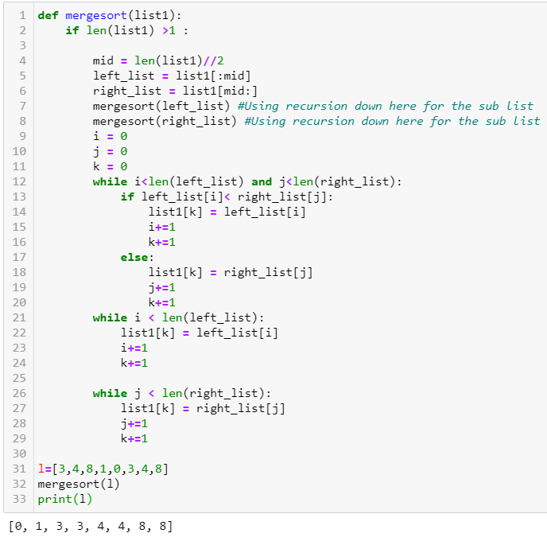
Merge Sort

Slide 44
Merge Sort
at ﬁrst recursion level
n/2 elements in each list
O(n) + O(n) = O(n) where n is len(L)
at second recursion level
n/4 elements in each list
two merges O(n) where n is len(L)
each recursion level is O(n) where n is len(L)
dividing list in half with each recursive call
O(log(n)) where n is len(L)
overall complexity is O(n log(n)) where n is len(L)
The average complexity of merge sort is O (n log (n) )

Slide 45
Quick Sort
Like merge sort, quick sort uses a divide and conquer approach. The algorithm is slightly more complicated, but in standard implementations it is faster than merge sort, and its complexity in the worst case rarely reaches O (n ^ 2).
It consists of three stages:
One pivot element is selected.
All elements smaller than the pivot will be shuffled to the left of it, the rest - to the right. This is called a split operation.
The 2 previous steps are recursively repeated to each new list, where the new pivots will be smaller and larger than the original, respectively.
Notes:
https://pythonru.com/osnovy/top-5-algoritmov-sortirovki-na-python

Slide 46
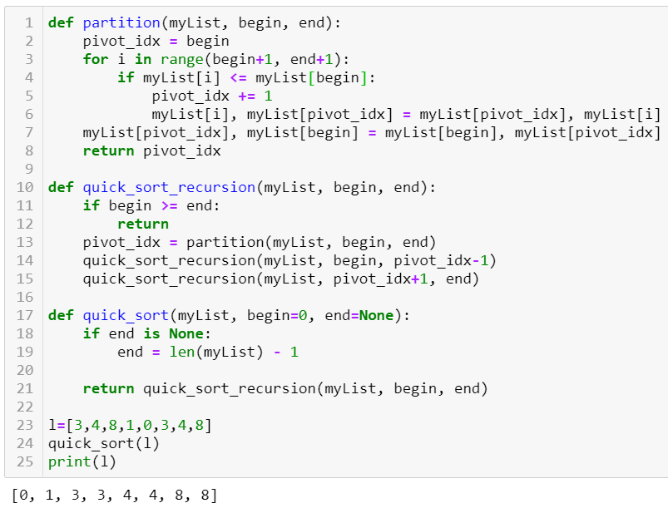
Quick Sort
Notes:
https://pythonru.com/osnovy/top-5-algoritmov-sortirovki-na-python

Slide 47
Sorting Algorithms Conclusion
Bubble sort is the slowest of all algorithms. It might be useful as an introduction to sorting algorithms, but not practical.
Quick sort lives up to its name well, almost twice as fast as merge sort, and does not require additional space for the resulting array.
Insertion sort performs fewer comparisons than selection sort and should actually perform better.
Notes:
https://webdevblog.ru/algoritmy-sortirovki-v-python/

Slide 48
Complexity Analysis

Slide 49
Complexity Analysis
Efficiency of an algorithm depends on two parameters:
1. Time Complexity
2. Space Complexity
Time Complexity: Time complexity is defined as the number of times that a specific collection of commands is executed, not the total time. This is because the total time taken also depends on some external factors like the compiler used, processor speed, etc.
Space Complexity: Space Complexity is the total memory space required by the program for its execution.
Notes:
https://webdevblog.ru/algoritmy-sortirovki-v-python/

Slide 50
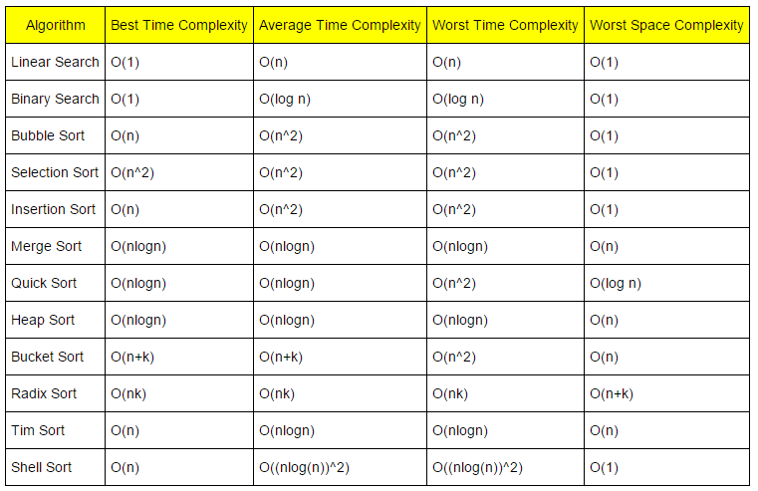
Complexity Analysis
Notes:
https://webdevblog.ru/algoritmy-sortirovki-v-python/

Slide 51
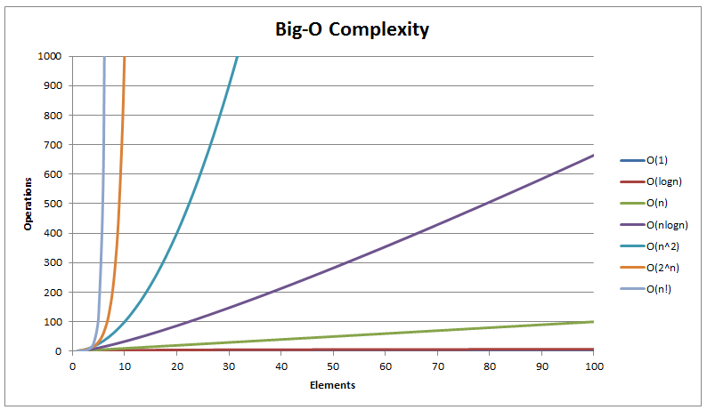
Complexity Analysis
Notes:
https://webdevblog.ru/algoritmy-sortirovki-v-python/

Slide 52
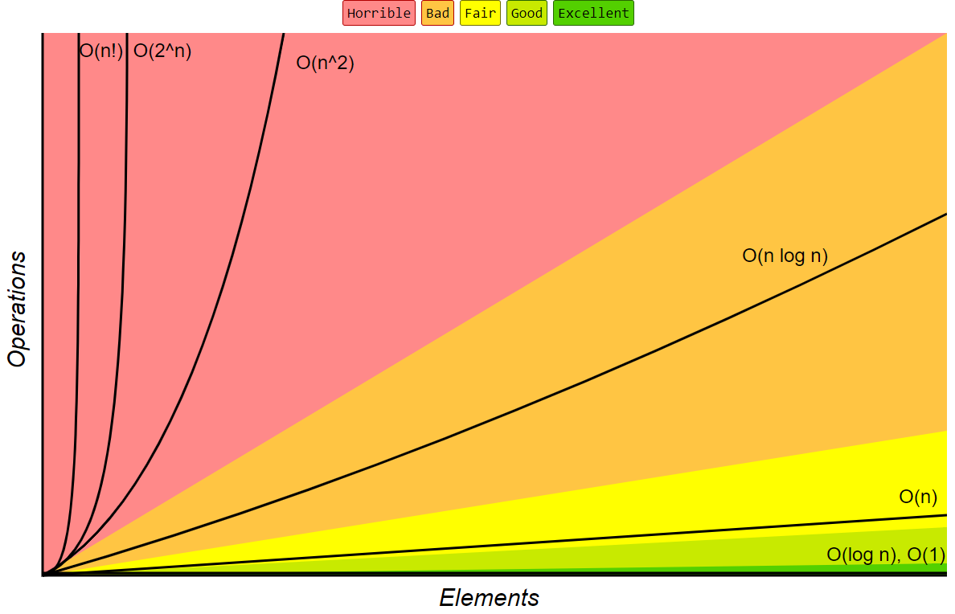
Complexity Analysis
Notes:
https://webdevblog.ru/algoritmy-sortirovki-v-python/

Slide 53
Thank you!

